Slide 1

UNIVERSITY OF HYDERABAD, MBA PROGRAM
Using Big Data Analytics
Vipin Kumar | Roll No: 24MBMB13 | MBA (Business Analytics) Capstone Presentation

Slide 2

Project Overview
01
Goal
The main goal is to apply Big Data Analytics for breast cancer detection and prediction.
02
Tools
Utilized tools include PySpark, scikit-learn, and Plotly for effective data analysis and visualization.
03
Dataset
The project uses the dataset workspace.default.breast_cancer_big_data_dataset for comprehensive analysis and insights.

Slide 3


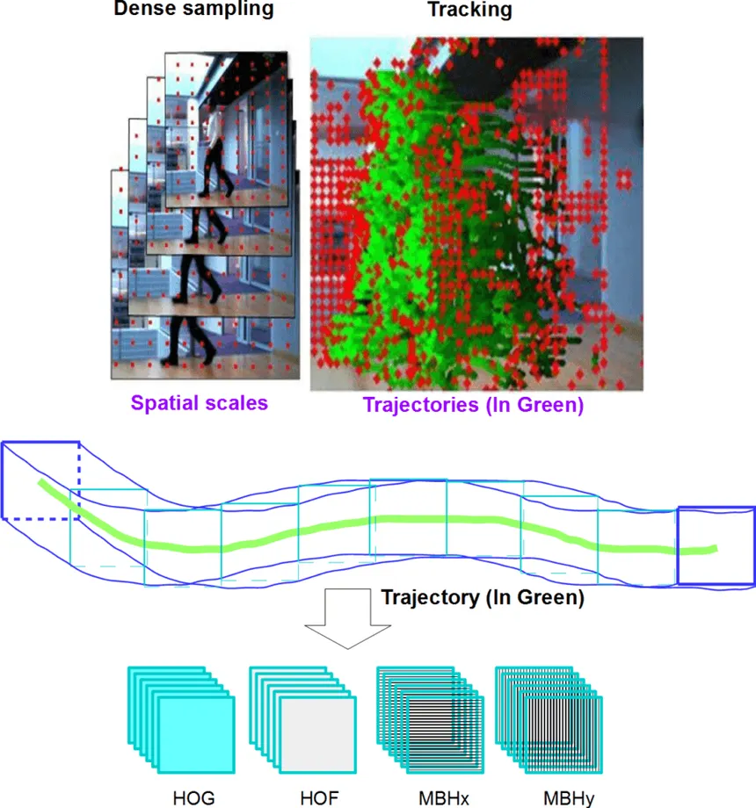
Detection and Feature Importance Analysis
Logistic Regression
Random Forest
Feature Analysis
Achieved accuracy metrics, revealing diagnostic capabilities.
Enhanced accuracy and predictive power for detection.
Identified key predictors for early breast cancer diagnosis.

Slide 4
Pattern Discovery and Risk Prediction
Algorithm
Clusters
Models
Implemented K-Means algorithm to identify clusters.
Analyzed patient groups with distinct tumor characteristics.
Utilized Random Forest and GBT for prediction.

Slide 5
Thank You
24mbmb13uohyd.ac.in

